Slide 1

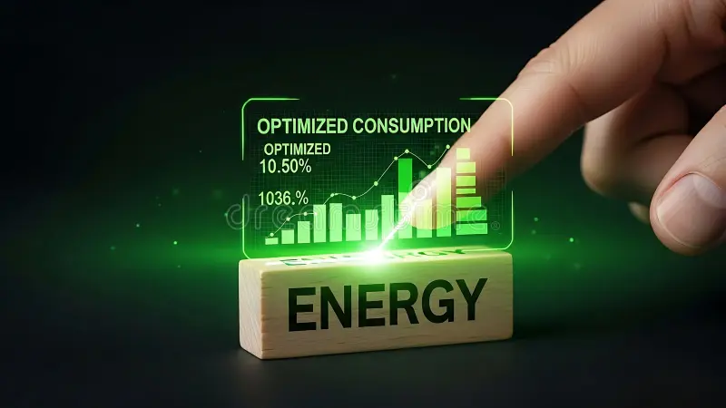
World Wide Energy Consumption Analysis using SQL

Slide 2
About Team Members
👤M. Sandeep (MCA) About Me: Passionate about data and problem solving. Why Data Science: Interested in analyzing data and extracting insights to support decision-making. Experience: Fresher 🔗LinkedIn: [https://www.linkedin.com/in/sandeep-marpaka-859626374/] 🔗GitHub: [https://github.com/SandeepMarpaka?tab=overview&from=2026-02-01&to=2026-02-23] | 👤V Amar Kanth (B.Tech) About Me: Interested in technology and data-driven solutions. Why Data Science: Excited about transforming raw data into meaningful insights for business growth. Experience: Fresher 🔗LinkedIn: [https://www.linkedin.com/in/amarkanthv/] 🔗GitHub: [https://github.com/amar-kanth] | 👤V Sharanya (B.Sc) About Me: Enthusiastic learner with interest in data analysis. Why Data Science: Motivated to explore patterns in data and solve real-world problems. Experience: Fresher 🔗LinkedIn: [https://www.linkedin.com/in/sharanya-sharanya/] 🔗GitHub: [https://github.com/sharanya-veerapeta]

Slide 3
Agenda
• Introduction
• Objective of the Project
• Dataset Overview
• Database Design (ER Diagram)
• Key Analysis Questions (Use Cases)
• SQL Analysis & Results
• Conclusion (Key Findings)
• Experience & Challenges
• Q&A

Slide 4
INTRODUCTION
This project focuses on analyzing global energy consumption data.
We aim to understand:
• Relationship between GDP, emissions, and population
• Trends in global energy usage
• Impact of economic growth on environment
Data Source: EIA (Energy Information Administration)

Slide 5
OBJECTIVE OF THE PROJECT
• To analyze global energy data using SQL
• To identify patterns in emissions, GDP, and population
• To understand how economic growth affects energy usage
• To generate meaningful insights for decision-making

Slide 6
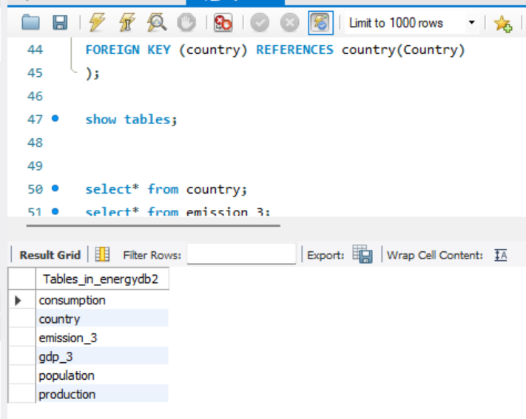
DATASET OVERVIEW
The dataset consists of 6 tables:
• country (central table)
• consumption
• production
• emission_3
• gdp_3
• population
All tables are connected using country as foreign key.

Slide 7
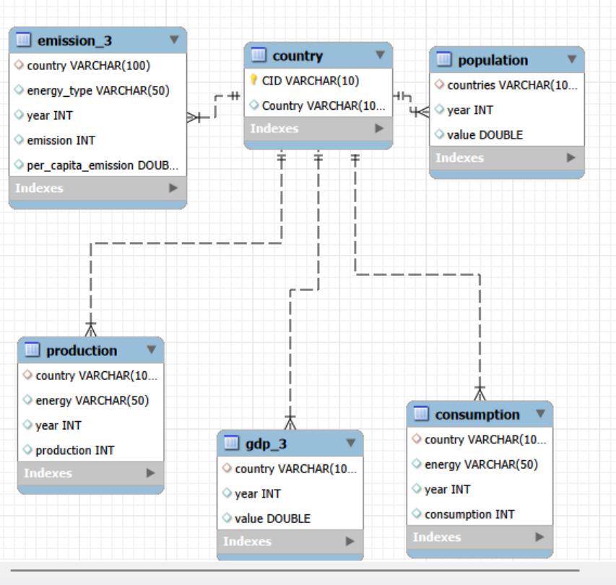
ER DIAGRAM(Database Design)
• country is the central table
• One-to-many relationships exist
• All tables are linked through country
Example:
country → emission_3
country → population
country → production

Slide 8
KEY ANALYSIS QUESTIONS (USE CASES)
• What is total emission per country?
• What are top countries by GDP?
• How have emissions changed over time?
• What is emission-to-GDP ratio?
• How does population affect emissions?
• What is global average trend?

Slide 9
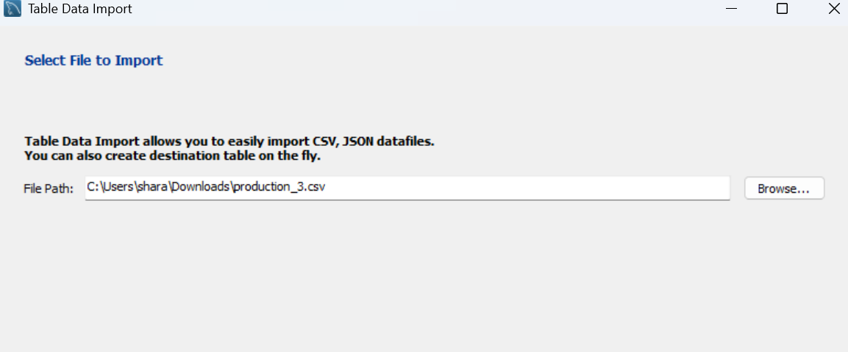
DATA PREPARATION
• Created database in MySQL
• Created tables using SQL queries
• Imported CSV files using import wizard
• Established relationships using foreign keys
• Verified data using SELECT queries

Slide 10
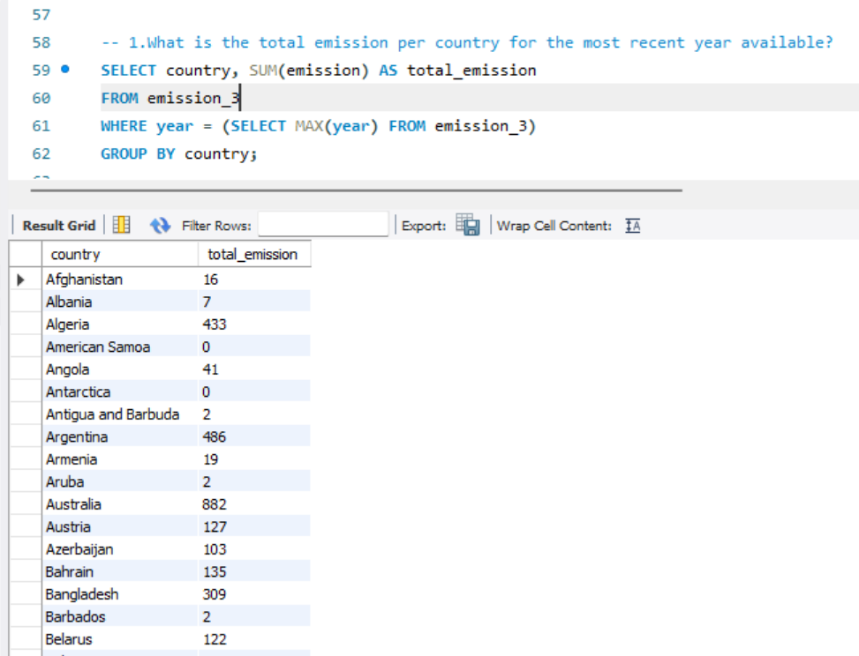
SAMPLE SQL QUERIES
SELECT country, SUM(emission)
FROM emission_3
GROUP BY country;
SELECT year, AVG(value)
FROM gdp_3
GROUP BY year;

Slide 11
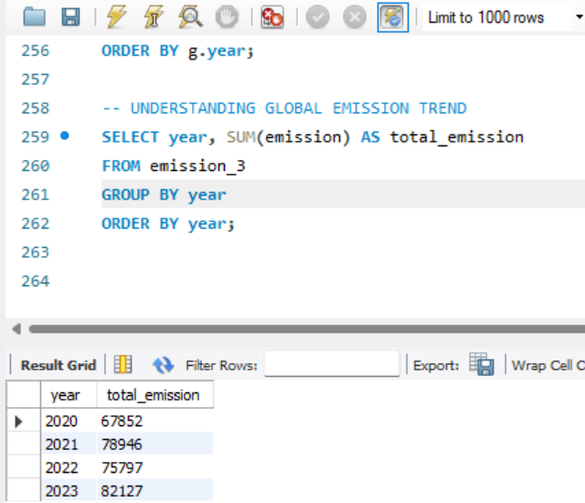
GLOBAL EMISSION TREND
• Emissions increase year by year
• Growth is consistent across years
• Indicates rising global energy consumption

Slide 12
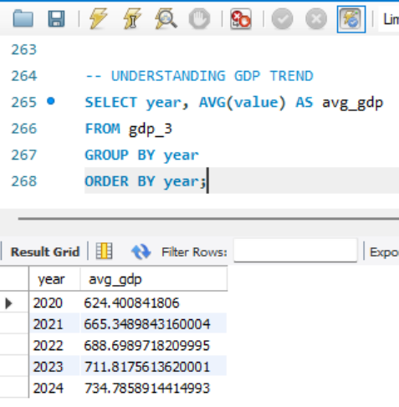
GDP TREND
• GDP is increasing globally
• Shows economic growth
• Growth is steady across years

Slide 13
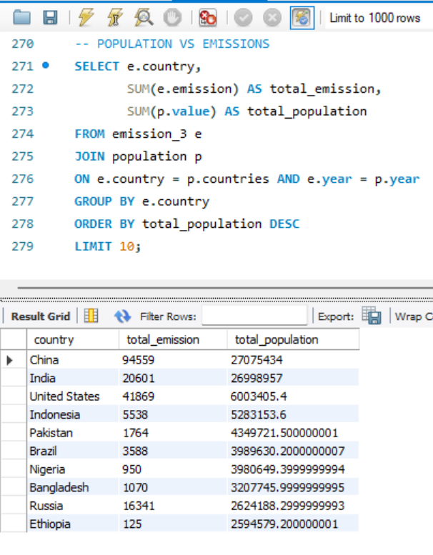
POPULATION VS EMISSIONS
• Population growth increases energy demand
• Higher population → higher emissions
• But industrialization also plays a key role

Slide 14
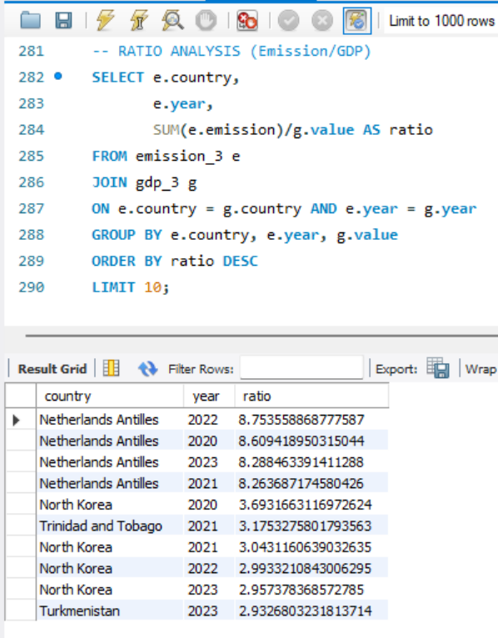
RATIO ANALYSIS
• Measures environmental efficiency
• High ratio → more pollution per GDP
• Low ratio → better efficiency

Slide 15
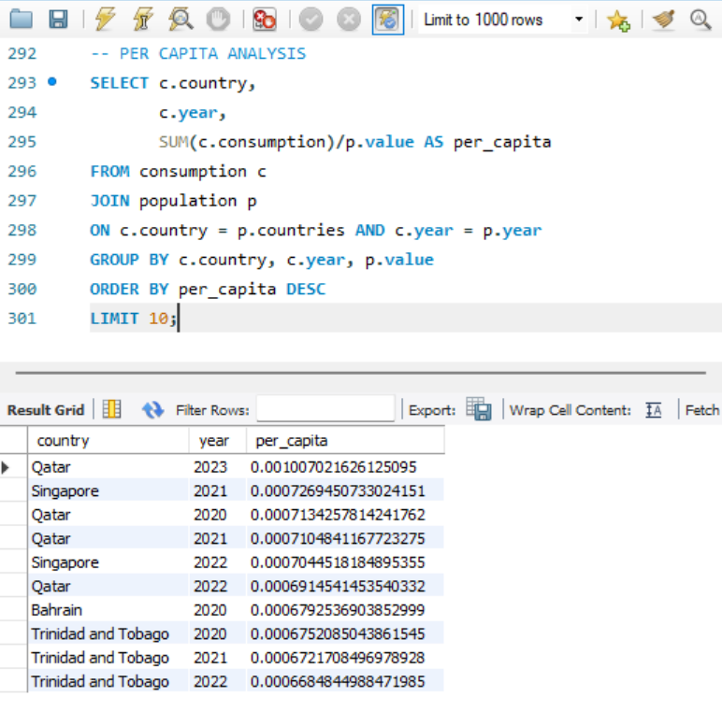
PER CAPITA ANALYSIS
• Consumption per capita varies across countries
• Developed countries → higher usage
• Developing countries → lower usage

Slide 16
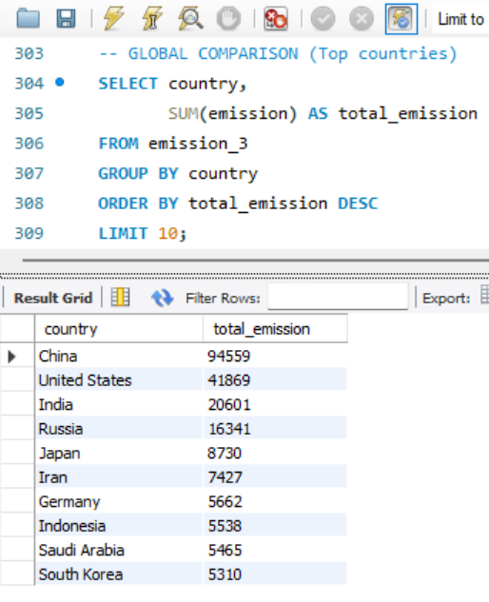
GLOBAL COMPARISON
• China is the largest emitter
• USA has high emissions despite lower population
• India has high population but moderate emissions

Slide 17
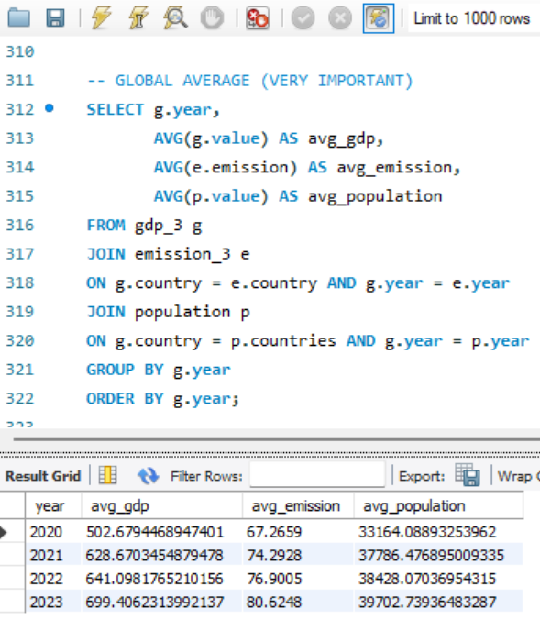
GLOBAL AVERAGE ANALYSIS
• GDP is increasing
• Emissions are increasing
• Population is increasing
All three show upward trend

Slide 18
KEY FINDINGS (CONCLUSION)
• GDP, population, and emissions are increasing
• Economic growth leads to higher energy demand
• Few countries dominate global emissions
• Industrialization impacts emissions more than population

Slide 19
EXPERIENCE & CHALLENGES
• Worked with real-world dataset
• Improved SQL and analytical skills
• Faced challenges in joins and data cleaning
• Learned database design and relationships

Slide 20

Questions & Answers

Slide 21

THANK YOU

